Slide 1
OBJECT ORIENTED PROGRAMMING THROUGH C++
PROJECT REVIEW 1&2
Course Instructor: Presented by:
Thoranti Vijaya Lakshmi , M.Tech (Ph.D),
ASSISTANT PROFESSOR,
AIML DEPTARTMENT
ATTENDANCE MARKING SYSTEM
25B11AI875 | PALAMANI CHENCHU MAHESH
25B11AI018 | AKSHINTALA DEVI SRI CHARAN
25B11AI955 | PILLI LOKESH
26B21AI004 | GORLI KUSA RAJU

Slide 2



Content
Project Abstract
Problem Statement & Objectives
Planned Modules / Functions
Users of the system
Modules/Functionalities
Architecture Diagram
ER Diagram / DFD
Planning and Timeline Diagram
Role of each individual

Slide 3
Project Abstract
The Attendance Marking System is a C++ based application developed to automate student attendance management. The system allows the user to store student details, mark attendance, search for students, and display attendance records. calculates attendance percentage, and identifies students with attendance below 75%. It replaces manual attendance registers with a simple and efficient computerized solution. The project uses Object-Oriented Programming concepts such as classes, objects, encapsulation, and member functions to provide a structured and reusable design.

Slide 4
Introduction
Attendance is an important part of student academic management. Traditionally, attendance is recorded manually using registers, which can be time-consuming and may lead to errors.
The Attendance Marking System is a C++-based application designed to simplify and automate the attendance management process. It allows teachers to store student details, mark attendance, search for student records, and view attendance information.
The system also calculates the attendance percentage and identifies students whose attendance is below 75%. The project uses Object-Oriented Programming concepts such as classes, objects, encapsulation, and member functions to provide a structured and reusable solution.

Slide 5
Problem Statement & Objectives
Problem Statement
Maintaining attendance manually is time-consuming and prone to errors. Teachers may face difficulties in tracking student attendance records accurately.
Objectives
1.Store student information efficiently.
2.Mark attendance electronically.
3.Search student records quickly.
4.Display attendance details whenever required.
5.Reduce manual work and improve accuracy.
6.Calculate attendance percentage automatically.
7.Identify students having attendance below 75%.

Slide 6
Novelty of the Project
Automated Attendance Management: Reduces the need for maintaining attendance manually.
Automatic Percentage Calculation: Calculates each student's attendance percentage automatically.
Low Attendance Detection: Identifies students whose attendance is below 75%.
Quick Student Search: Allows student records to be searched using the roll number.
Simple and User-Friendly System: Provides a straightforward menu-based interface for easy operation.
Object-Oriented Design: Uses C++ concepts such as classes, objects, encapsulation, and member functions for organized and reusable code.
Reduced Human Errors: Helps improve accuracy compared with manual attendance recording.

Slide 7
Planned Modules / Functions
1.Student Management Module
Add student details.
Store roll number and name.
2.Attendance Module
Mark attendance for students.
Update attendance count automatically.
3.Search Module
Search students using roll number.
Display student details instantly.
4.Percentage Calculation Module
Calculate attendance percentage.
Identify students with attendance below 75%.
5.Display Module
View all student records.
how attendance status of each student.
6.Exit Module
Safely terminate the application.

Slide 8
Users of the System
Faculty / Teacher
Adds student details.
Marks attendance.
View attendance percentage.
Identify students with low attendance
Views attendance reports.
Students
Attendance records are maintained in the system.
Can check attendance status through the teacher.
Administrator
Maintains and manages the overall attendance system.

Slide 9
Functions and Modules
1. Student Management Module
addStudent() – Adds roll number and student name.
Initializes attendance count to 0.
Validates the roll number input.
2. Attendance Module
markAttendance() – Increases attendance count when the student is present.
Takes Y/N input for each student.
Displays attendance confirmation.
3. Student Search Module
getRollNo() – Returns the student's roll number.
Searches for a student using the roll number.
Displays Student Not Found if no matching record exists.

Slide 10
Functions and Modules
4. Attendance Percentage Module
getAttendancePercentage() – Calculates attendance percentage.
Formula: Attendance % = (Present Days / Total Working Days) × 100
Handles zero working days safely.
5. Low Attendance Detection Module
displayIfBelow75() – Checks whether attendance is below 75%.
Displays students who have low attendance.
6. Display & Menu Module
displayStudent() – Displays roll number, name, and present days.
Displays all student records.
Menu provides options for Display, Mark Attendance, Search, Percentage, Low Attendance, and Exit.
Input validation prevents invalid menu and numeric inputs.

Slide 11
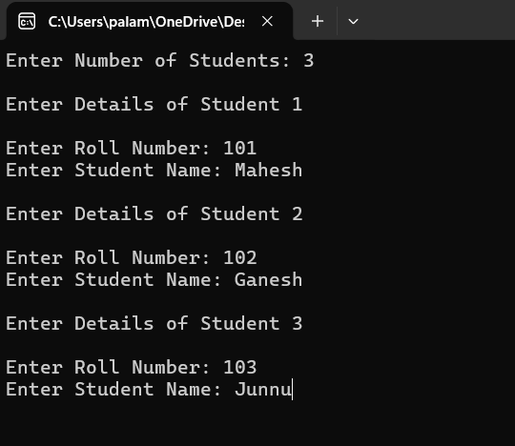
Implementation
The system is implemented using C++ and Object-Oriented Programming (OOP) concepts.
A Student class is used to store roll number, student name, and attendance count.
An array of student objects stores the details of up to 10 students.
Student details are entered using the addStudent() function.
Attendance is marked using Y/N input for each student.
The system calculates attendance percentage using the total working days.
Students with attendance below 75% are automatically identified.
A menu-driven interface allows the user to display, mark attendance, search, calculate percentage, detect low attendance, and exit.
Input validation is included to handle invalid numeric and menu inputs.

Slide 12
C++ Concepts
Classes and Objects – Student class is used to represent each student.
Encapsulation – Student data such as rollNo, name, and attendance is kept private and accessed through public functions.
Member Functions – Functions such as addStudent(), markAttendance(), and displayStudent() perform specific operations.
Arrays of Objects – Student s[10] stores details of multiple students.
Access Specifiers – private protects data, while public provides access to required functions.
Control Statements – if-else, switch, while, and do-while are used for decision-making and program flow.
Input Validation – cin.clear() and cin.ignore() handle invalid user input.
Functions with Parameters and Return Values – Used for attendance percentage calculation and student searching.

Slide 13
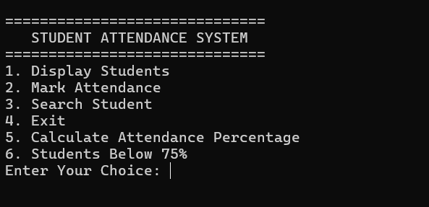
INPUT
Enter the number of students.
Enter each student's roll number.
Enter each student's name.
Select an option from the menu.
For attendance, enter Y for Present or N for Absent.
Enter the total working days for attendance percentage calculation.
Enter a roll number when searching for a student.

Slide 14
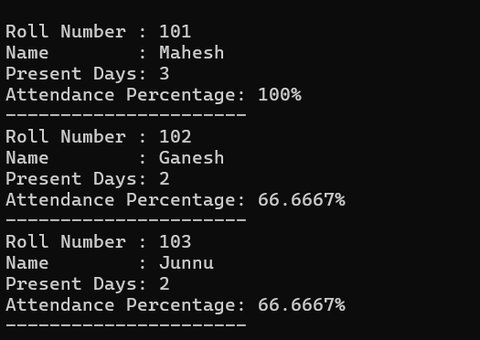
Expected Output
Displays all student details including roll number, name, and present days.
Displays "Attendance Marked Successfully!" when a student is present.
Displays "Student marked Absent." when a student is absent.
Displays the attendance percentage of each student.
Displays students whose attendance is below 75%.
Displays the searched student's details.
Displays "Student Not Found!" when the entered roll number does not exist.
Displays "Thank You!" when the user exits the system.

Slide 15
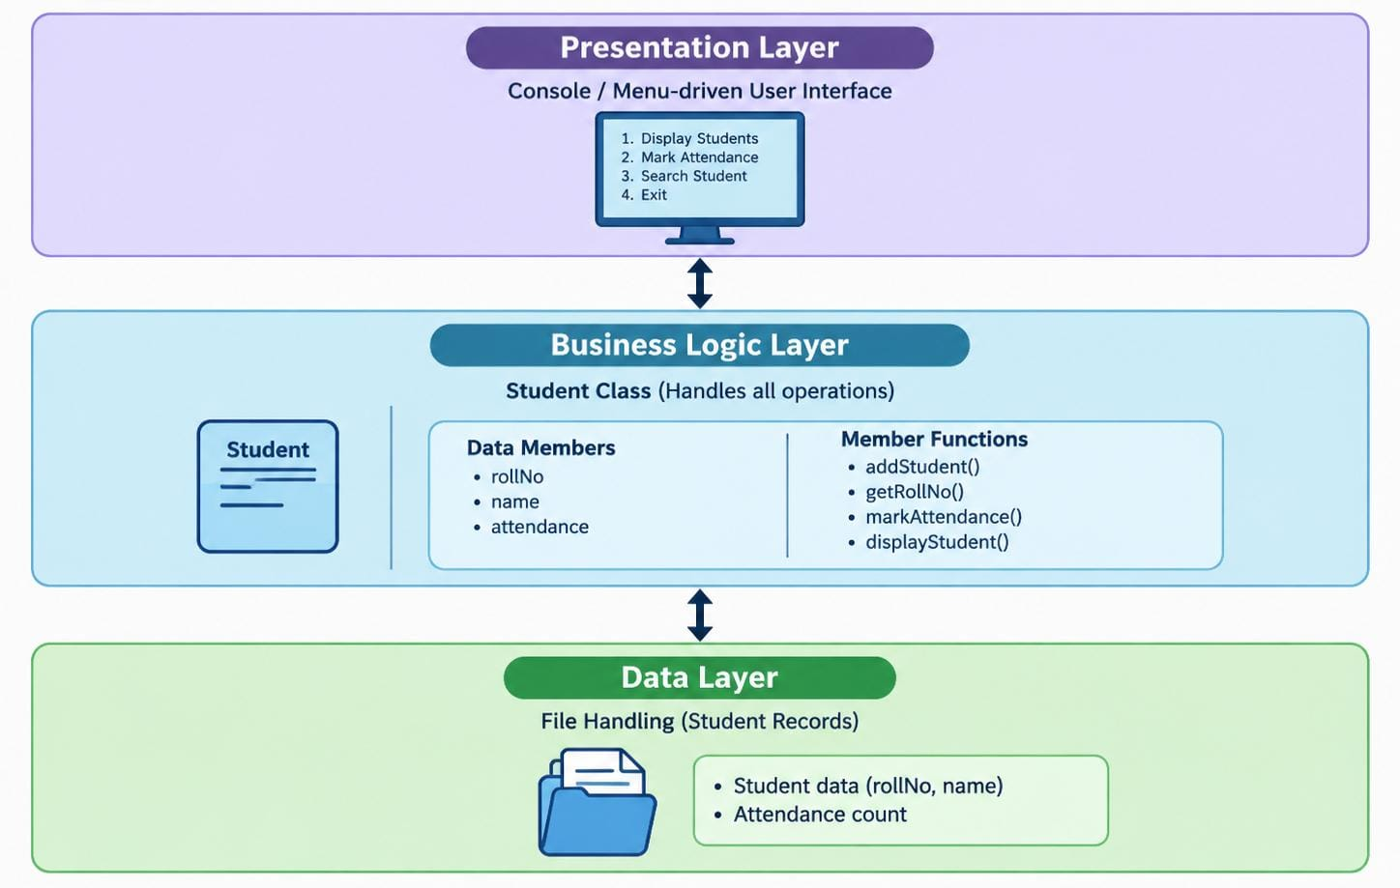
Architecture Diagram

Slide 16
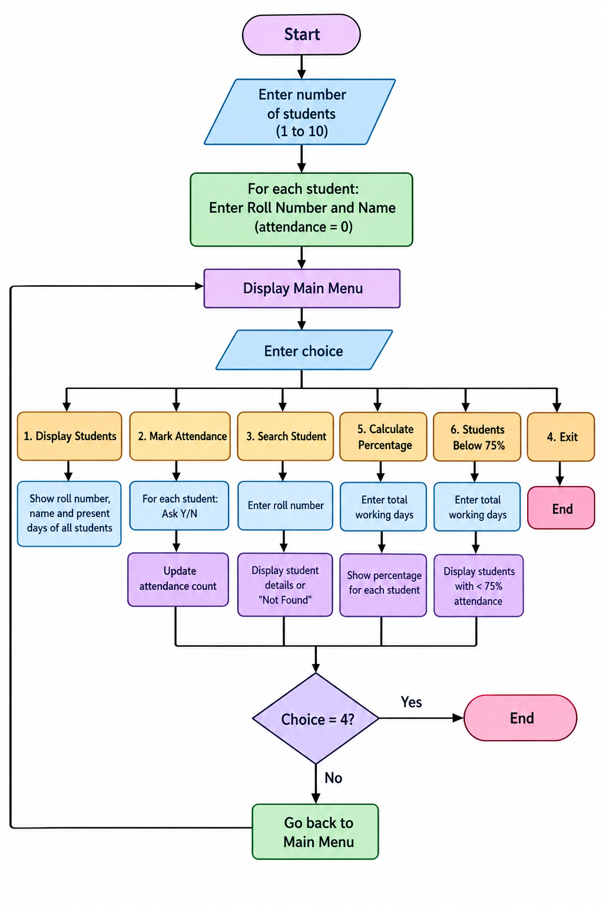
Flowchart

Slide 17
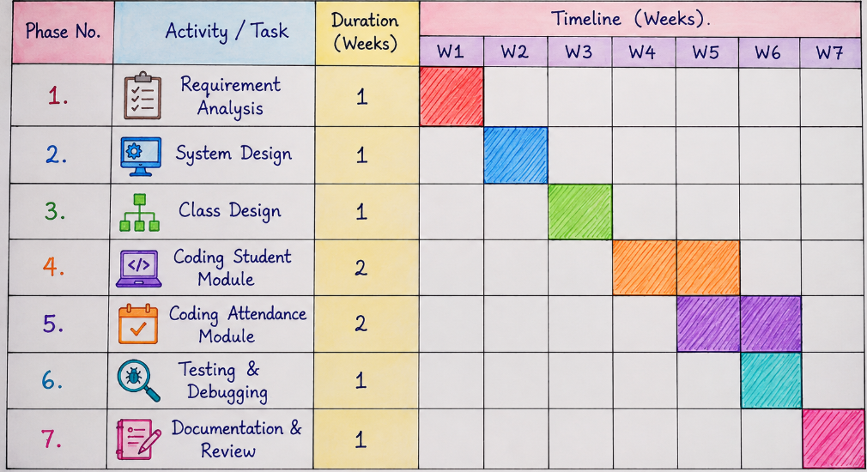
Planning and Timeline Diagram

Slide 18
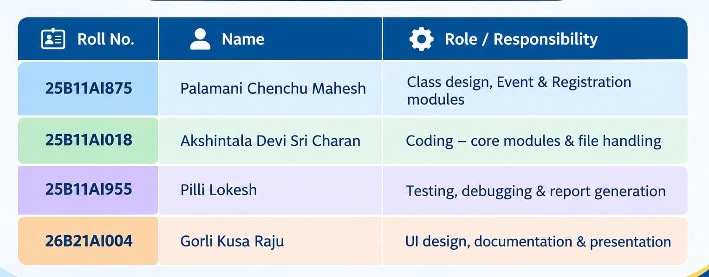
Role of Each Individual

Slide 19


